Slide 1
NHL Teams 101
Teacher: Jenna Ortiz

Slide 2
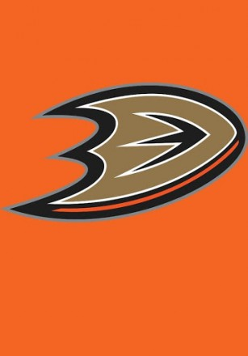
Anaheim Ducks
Founded in 1993 and play in the Pacific Division of the Western Conference
The team is named after the Disney movie, The Mighty Ducks, and was owned by Disney until 2005
Won the Stanley Cup in 2007
Only team to use orange rally towels

Slide 3
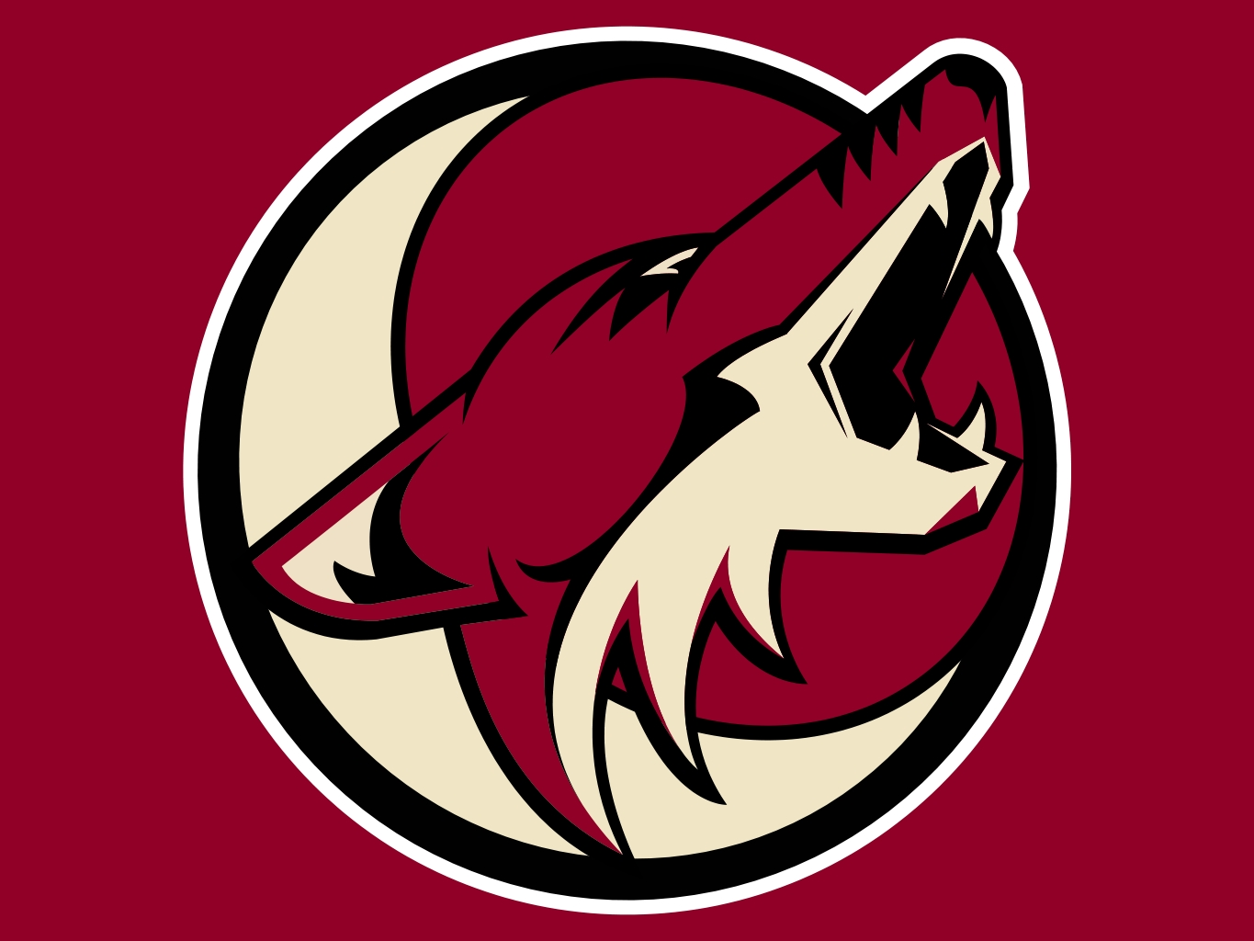
Arizona Coyotes
They play in Glendale, Arizona.
Founded: 1972 (as the Winnipeg Jets in the WHA)
Joined the NHL in 1979 (as the Jets)
Moved to Arizona in ’96 and play in the Pacific Division in the Western Conference
Fun fact: Wayne Gretzky was once the head coach
Not so fun fact: The city of Glendale tried to terminate their lease contract on the arena in 2015

Slide 4
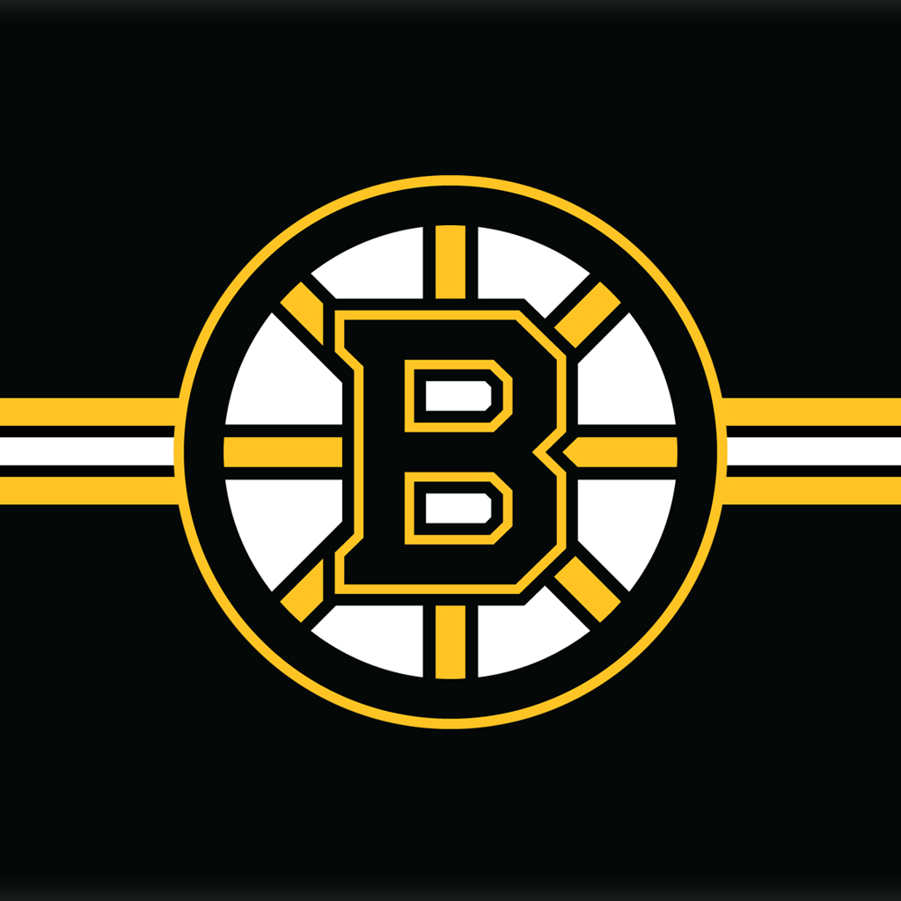
Boston Bruins
Oldest American Team (founded in 1924)
The captain, Zdeno Chara, is 6ft 9in and is the tallest NHL player. He also holds the record for the fastest slap shot at 108.8 mph
Have won six Stanley Cups
Play in the Atlantic Division of the Eastern Conference

Slide 5
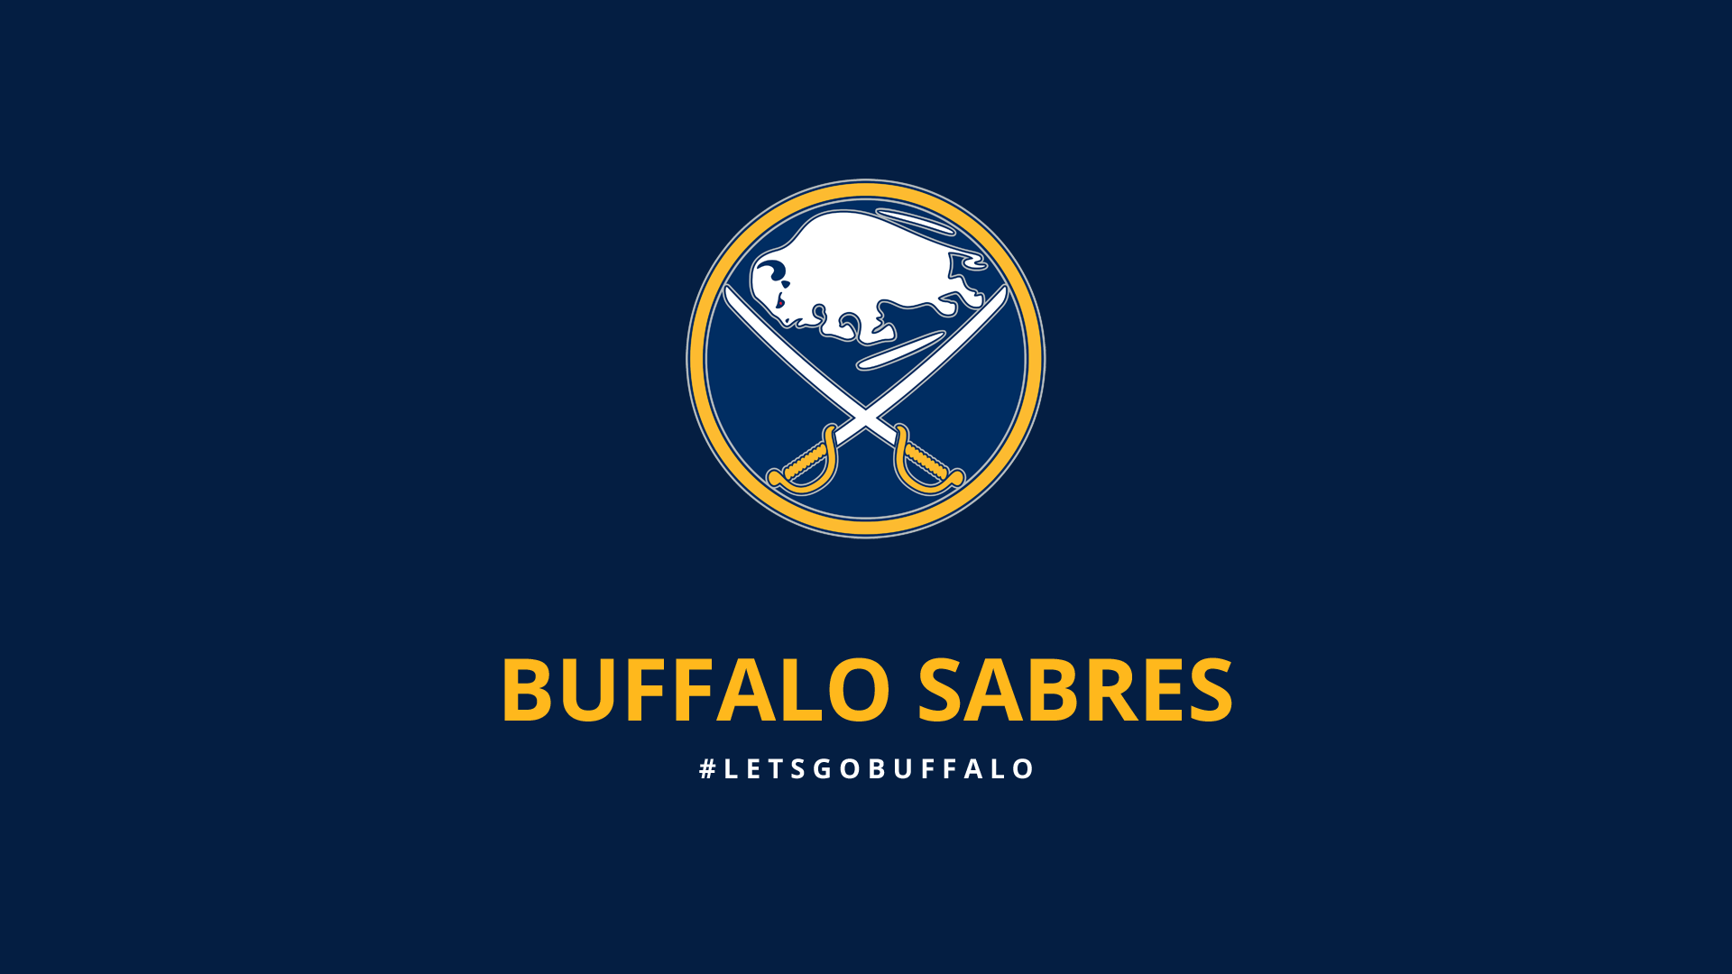
Buffalo Sabres
Founded: 1970
Fun fact: The team name was picked through a contest
Play in the Atlantic Division of the Eastern Conference

Slide 6
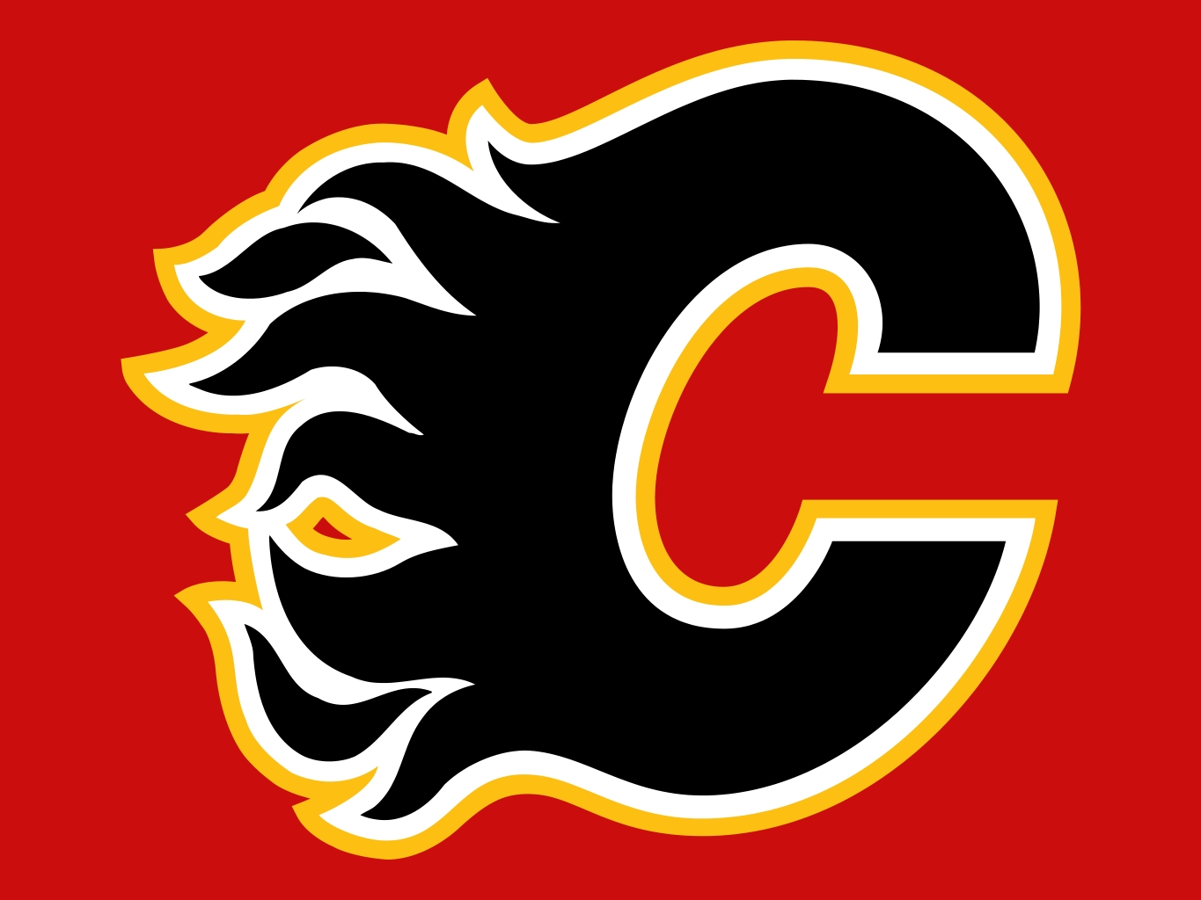
Calgary Flames
Founded in 1972 as the Atlanta Flames and moved to Calgary in 1980
Won the Cup in 1989
Play in the Pacific Division of the Western Conference
Fun fact: The Red Mile is the name for the street where Flames fans celebrate during their playoff runs (the area is famous due to its lack of nonviolence)

Slide 7
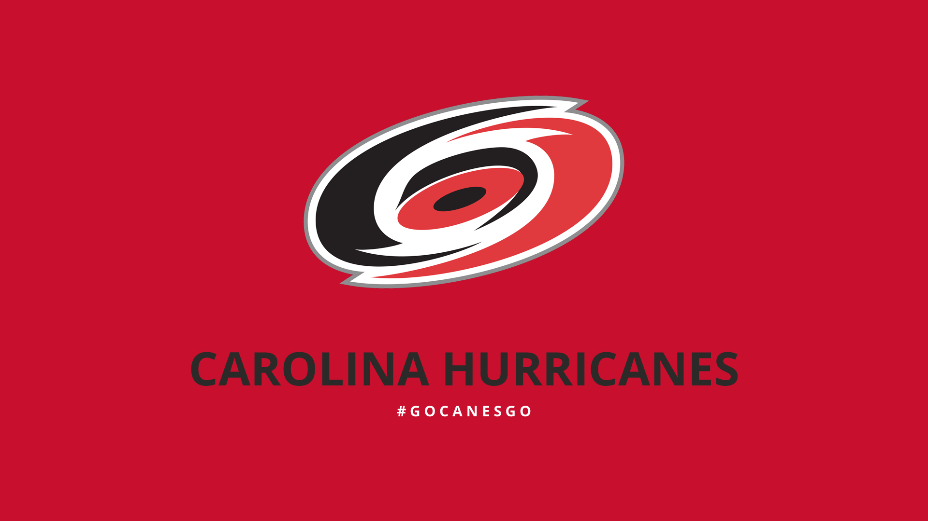
Carolina Hurricanes
Play in Raleigh, North Carolina and are in the Metropolitan Division of the Eastern Conference
Founded in 1972 as the New England Whalers, moved to the NHL and Hartford in 1979, and then moved to Raleigh in 1997
Won the Stanley Cup in 2006 and also won the first major league sports title for a team in N.C.

Slide 8
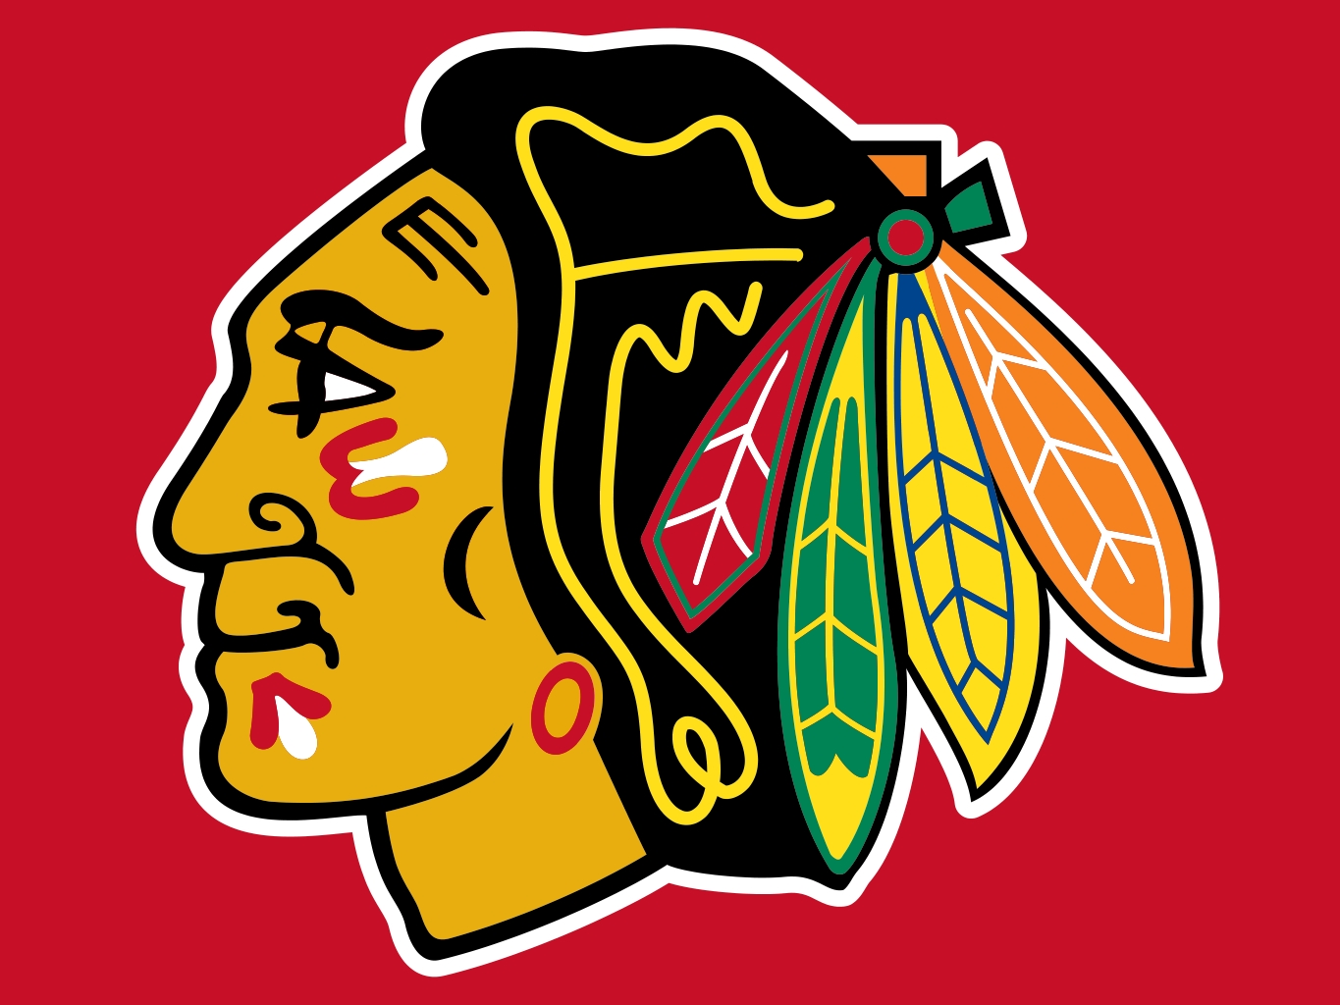
Chicago Blackhawks
Founded in 1926 and play in the Central Division of the Western Conference
Have won six Stanley Cups
Had not won a Cup since 1961 prior to their 2010 victory

Slide 9
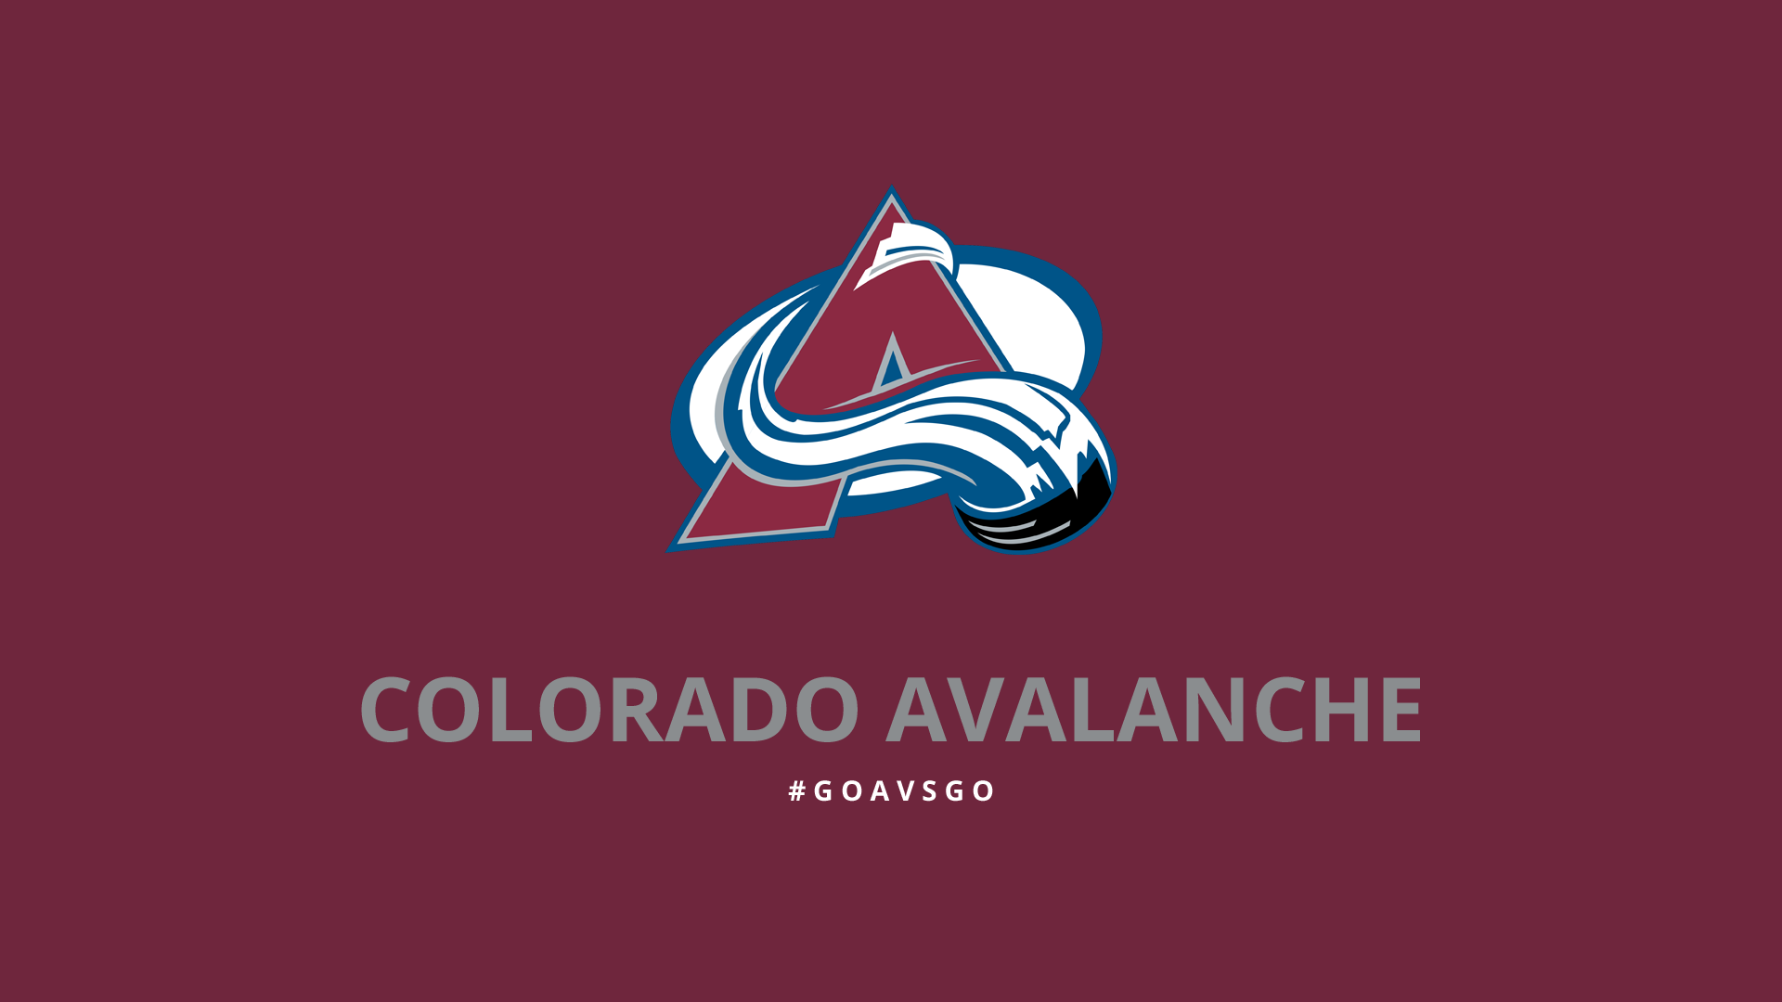
Colorado Avalanche
Play in Denver and are in the Central Division of the Western Conference
Founded in 1972 (as the Quebec Nordiques)
Moved to Colorado in 1995 and won the Stanley Cup in that season
Both of their Stanley Cups were won in their only two appearances in the Stanley Cup Final
First team in Denver to win a professional sports title

Slide 10
Columbus Blue Jackets
Founded on June 25th, 1997 as an expansion team for the 2000-2001 season
Named after Ohio’s contributions to the Civil War
Play in the Metropolitan Division of the Eastern Conference
At games, a cannon is fired when the team either scores a goal, wins, or when they appear on the ice

Slide 11
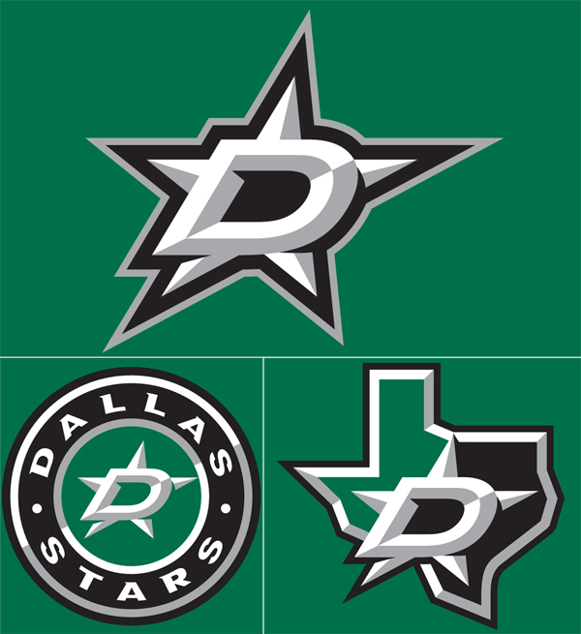
Dallas Stars
Founded in 1967 (as the Minnesota North Stars)
Moved to Dallas in 1993
Play in the Central Division of the Western Conference
Won the Stanley Cup in 1999 and were the first NHL team based in a sub tropical city to win the Cup

Slide 12
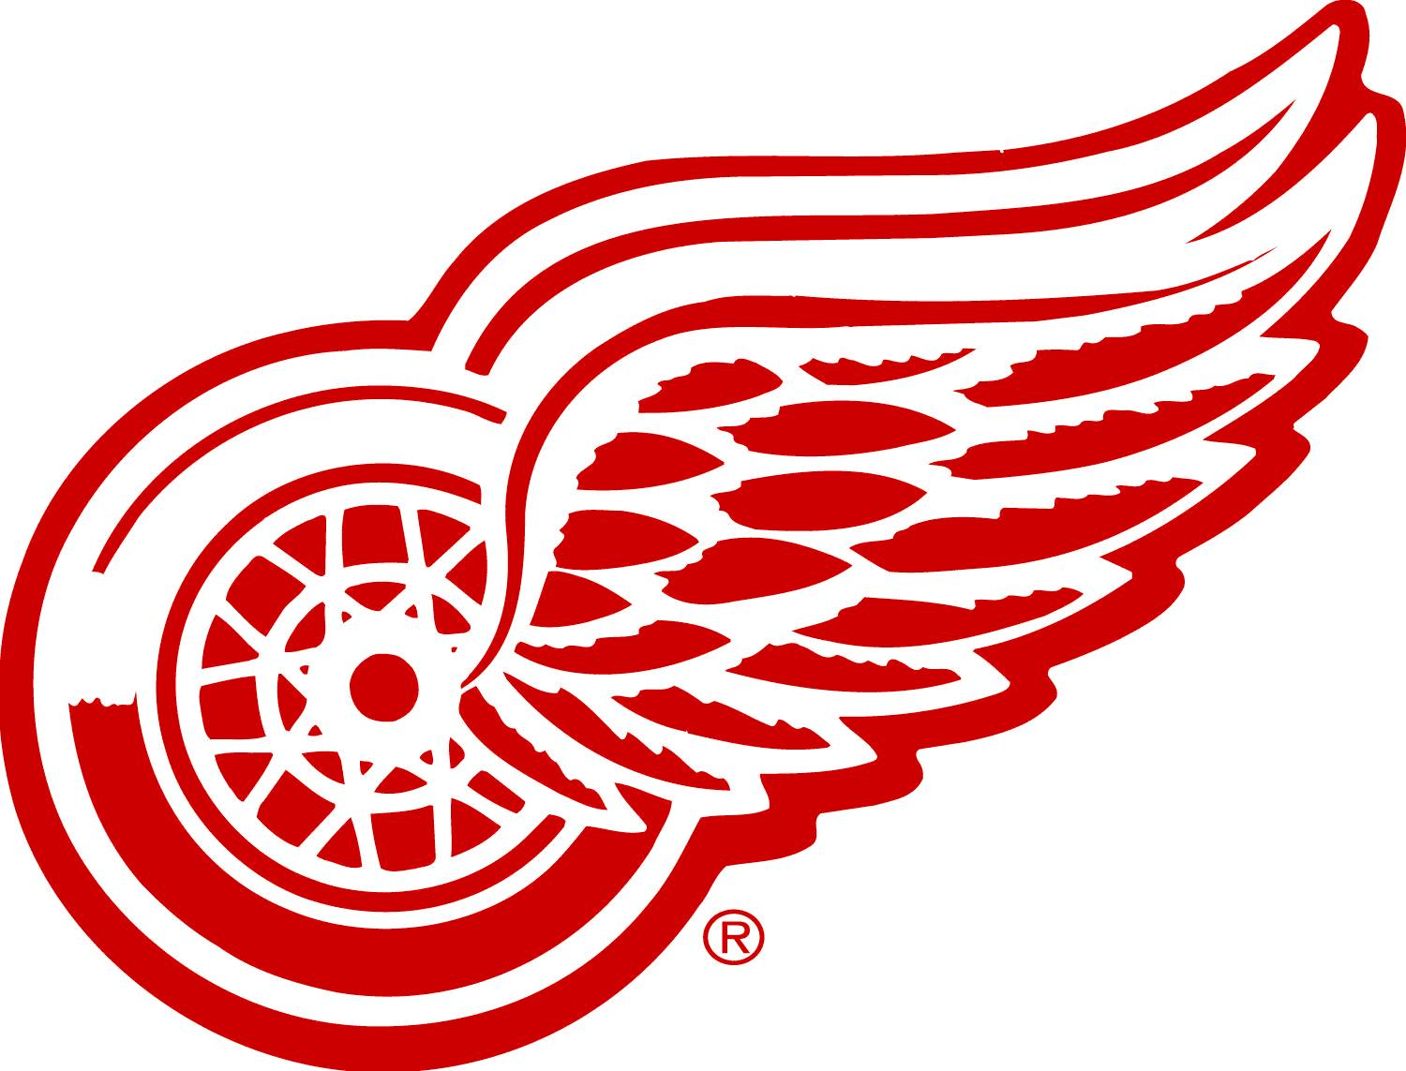
Detroit Red Wings
Founded in 1926 (as the Cougars and then the Falcons)
Play in the Atlantic Division of the Eastern Conference
Have won 11 Stanley Cups, which is the most for any American team
The Detroit area is described as “Hockeytown”

Slide 13
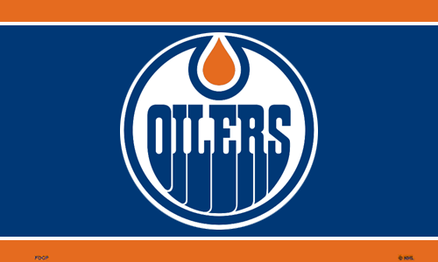
Edmonton Oilers
Founded on November 1, 1971, as the Alberta Oilers in the World Hockey Association and merged into the NHL in 1979 as the Edmonton Oilers
Play in the Pacific Division of the Western Conference
Achieved dynasty status for their 5 Stanley Cups in ‘84, ‘85, ‘87, ‘88, and ‘90
Wayne Gretzky is the best Oilers and NHL player of all time

Slide 14
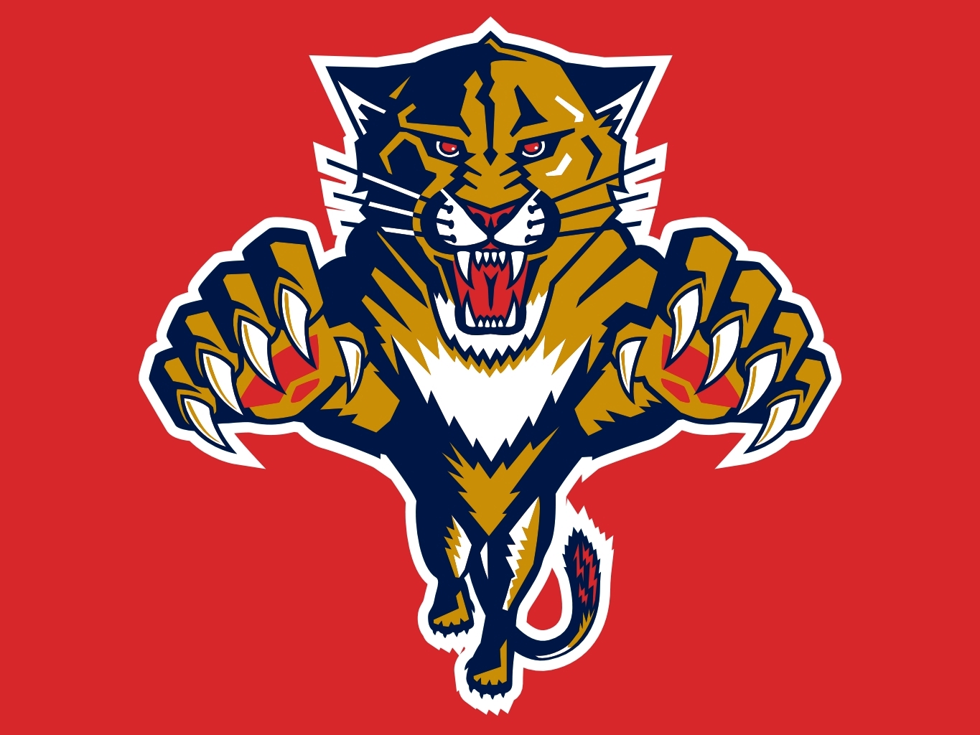
Florida Panthers
Play in Sunrise, FL and are in the Atlantic Division of the Eastern Conference
Were founded on December 10, 1992, the same day the Walt Disney Company were awarded a team in Anaheim
Not so fun fact: The team’s lowest attendance record was 7,311 people in 2014
There is hope! Rookie Aaron Ekblad won the Calder Memorial Trophy in 2015

Slide 15
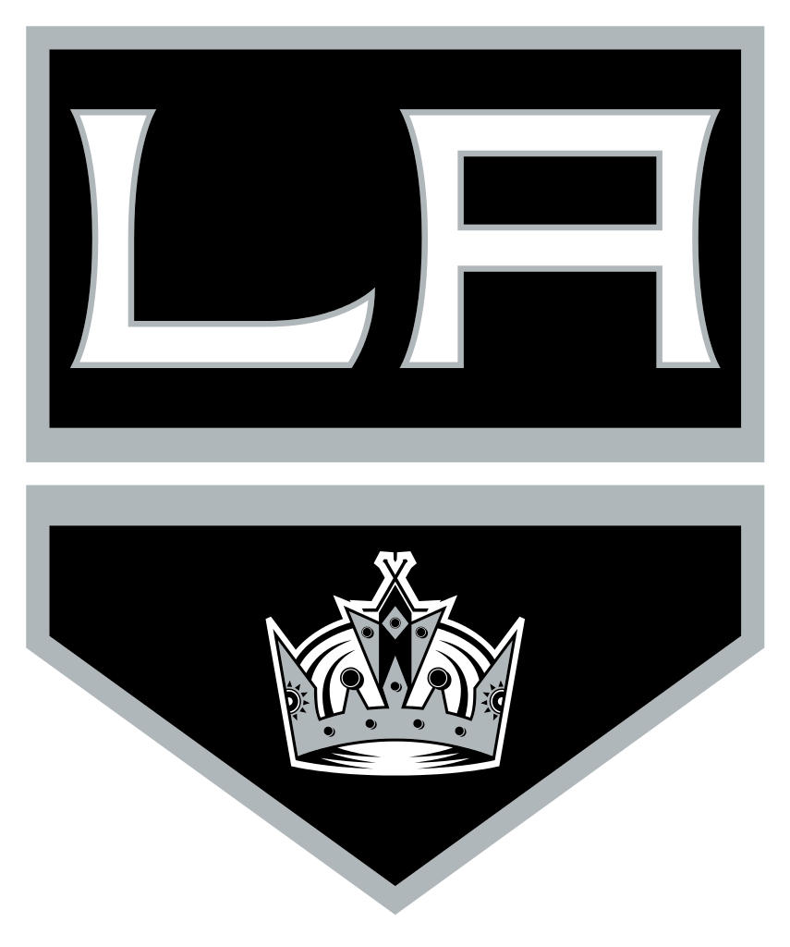
Los Angeles Kings
Founded in 1967 and play in the Pacific Division of the Western Conference
Won two Stanley Cups in ‘12 and ‘14
Wayne Gretzky played for the team from 1988-1996 and is credited for bringing more fans to the sport in the state of California

Slide 16
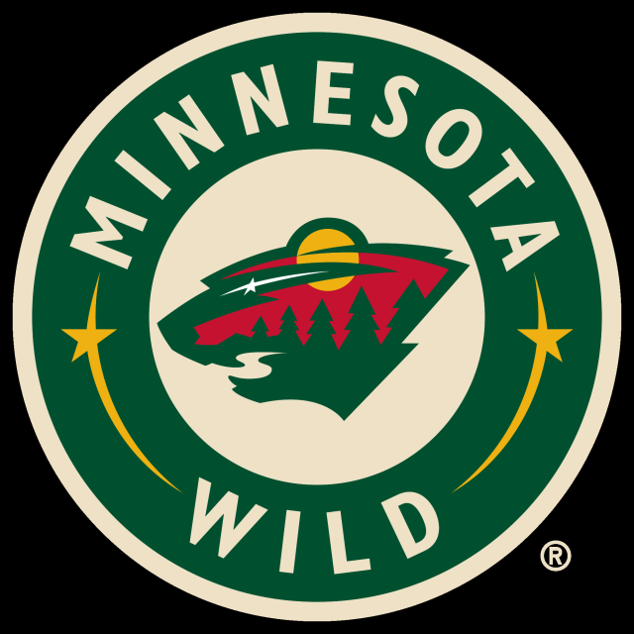
Minnesota Wild
Play in St. Paul, MN, and are in the Central Division of the Western Conference
Founded on June 25, 1997, but did not play until 2000
On the logo, the eye of the animal is a north star, which is a tribute to the former Minnesota North Stars
The Wild used to rotate their captains on a monthly basis instead of every couple of years. The current captain, Mikko Koivu, has been captain since 2009.

Slide 17
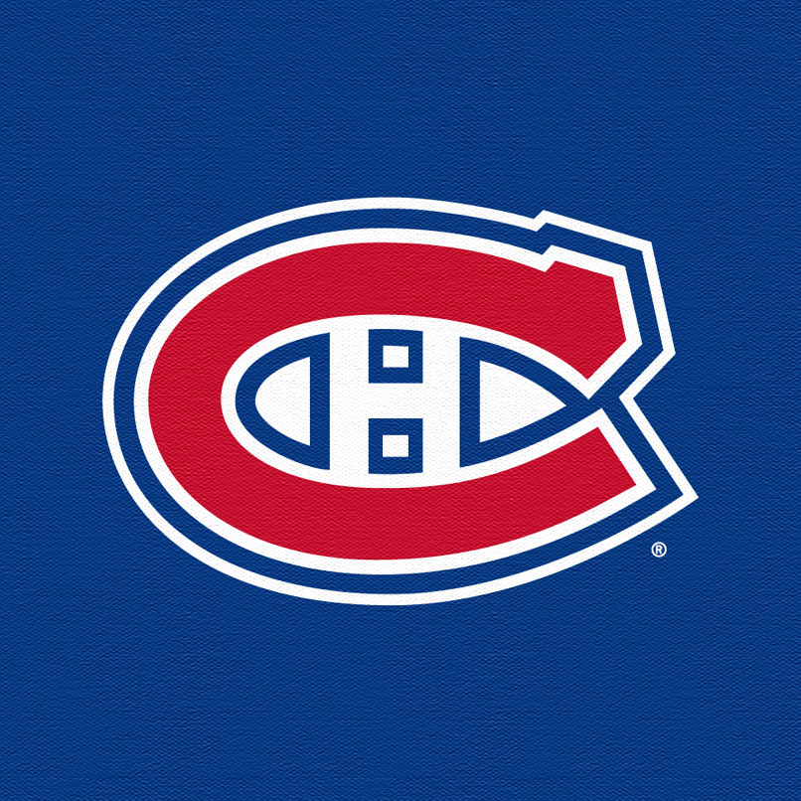
Montreal Canadiens
Founded in 1909, they are the oldest NHL team and they even predate the NHL itself
They are in the Atlantic Division of the Eastern Conference
They have won the most Stanley Cups in the league at the grand total of 24
The official name is le Club de Hockey Canadien. Their English nickname is the Habs, which is short for Les Habitants

Slide 18
Nashville Predators
Founded on June 25th, 1997, and play in the Central Division of the Western Conference
The logo is a sketch of a fossil found in Nashville in the 70s
The jerseys have a guitar pick on the shoulder with the Tennessee state tri-star inside, guitar-like lines on the numbers, and piano keys on the neck line inside the jersey.

Slide 19
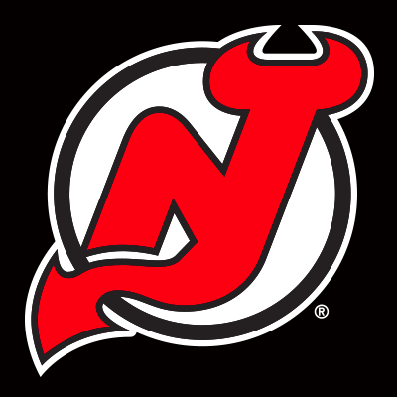
New Jersey Devils
Play in Newark, NJ, and are in the Metropolitan Division of the Eastern Conference
Founded in 1974 as the Kansas City Scouts, then moved to Denver and were the Colorado Rockies from ‘76-82
The only major league team to identify as a New Jersey team
They have won 3 Stanley Cups in ‘95, ‘00, and ‘03

Slide 20
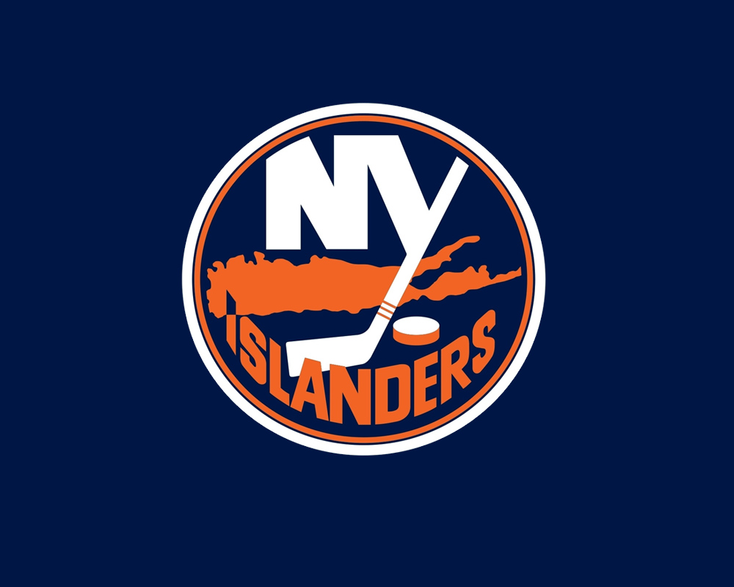
New York Islanders
Founded in 1972
Play in Brooklyn, and are also in the Metropolitan Division of the Eastern Conference
Won 4 straight Stanley Cups from 1980-83 and are recognized as a dynasty in the NHL

Slide 21
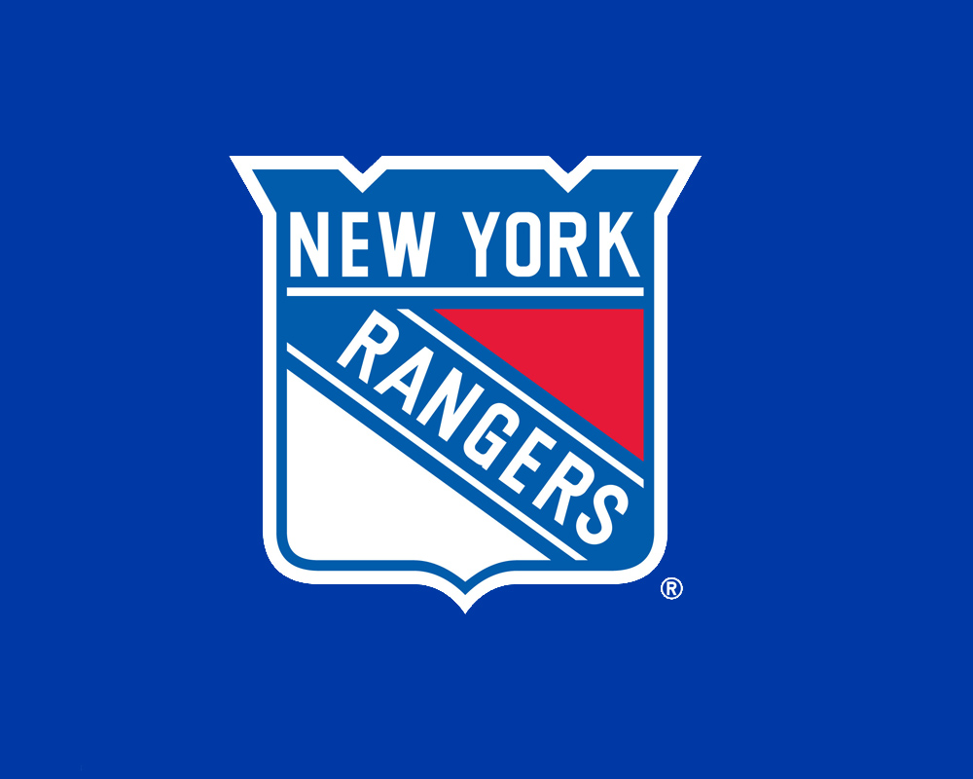
New York Rangers
Founded in 1926
Play in Manhattan and are also in the Metropolitan Division of the Eastern Conference
Have won 4 Stanley Cups in ’28, ‘33, ‘40, and ’94
Member of the Original Six NHL teams

Slide 22
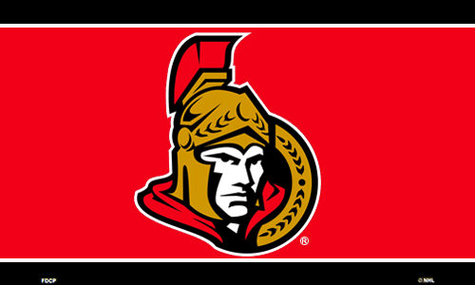
Ottawa Senators
Founded in 1990 but began playing in 1992
Play in the Atlantic Division of the Eastern Conference
Fans are known as the Sens Army
One of the best teams in attendance in the NHL

Slide 23
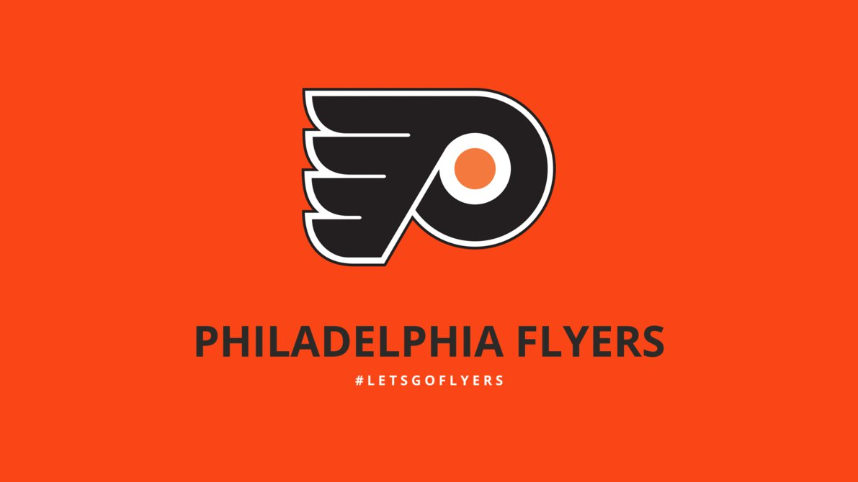
Philadelphia Flyers
Founded in 1967
Play in the Metropolitan Division of the Eastern Conference
Won 2 Stanley Cups in ‘74 and ‘75, and were the first expansion team to do so
The team name was selected through a contest and represents the speed of the game

Slide 24
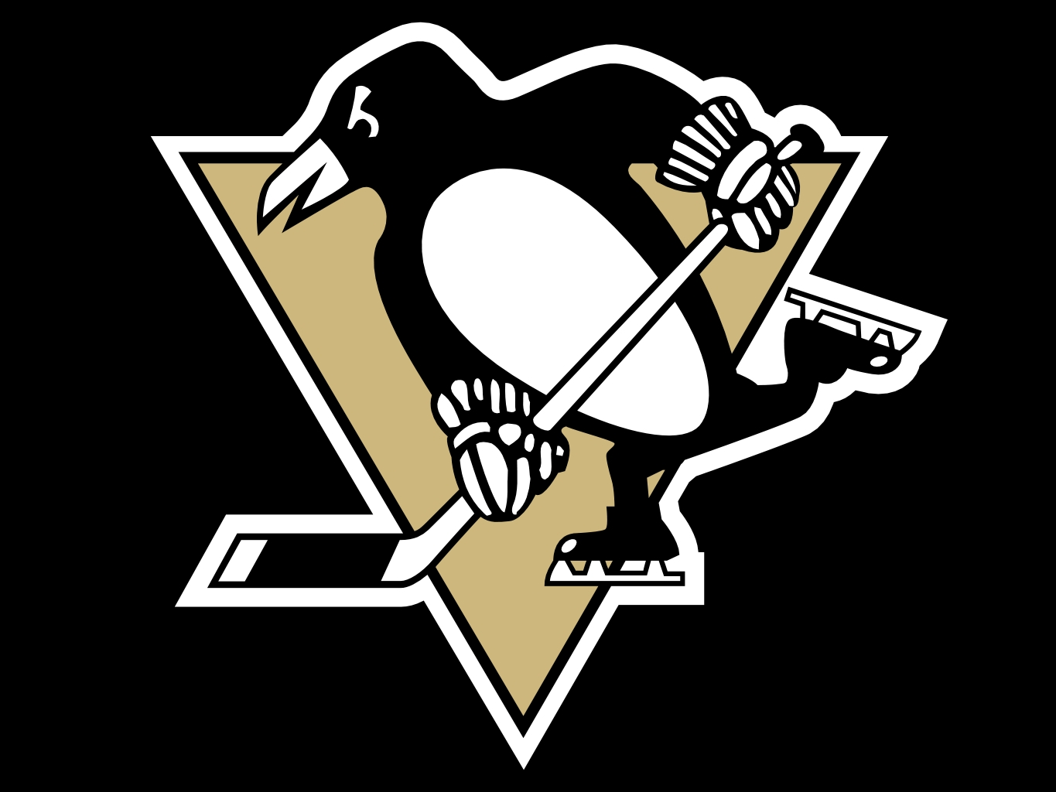
Pittsburgh Penguins
Founded in 1967
Play in the Metropolitan Division of the Eastern Conference
Have won 3 Stanley Cups in ‘91, ‘92, and ‘09
The NHL team to visit the White House
Penguins legend, Mario Lemieux, became the first player-owner in NHL history in 2001

Slide 25
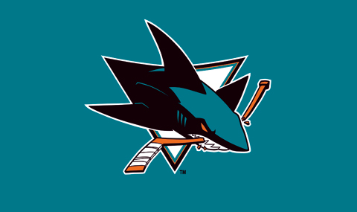
San Jose Sharks
Founded in 1991
Play in the Pacific Division of the Western Conference
The home arena is nicknamed “The Shark Tank”
A giant shark is used for the pre-game entrance of the home team

Slide 26
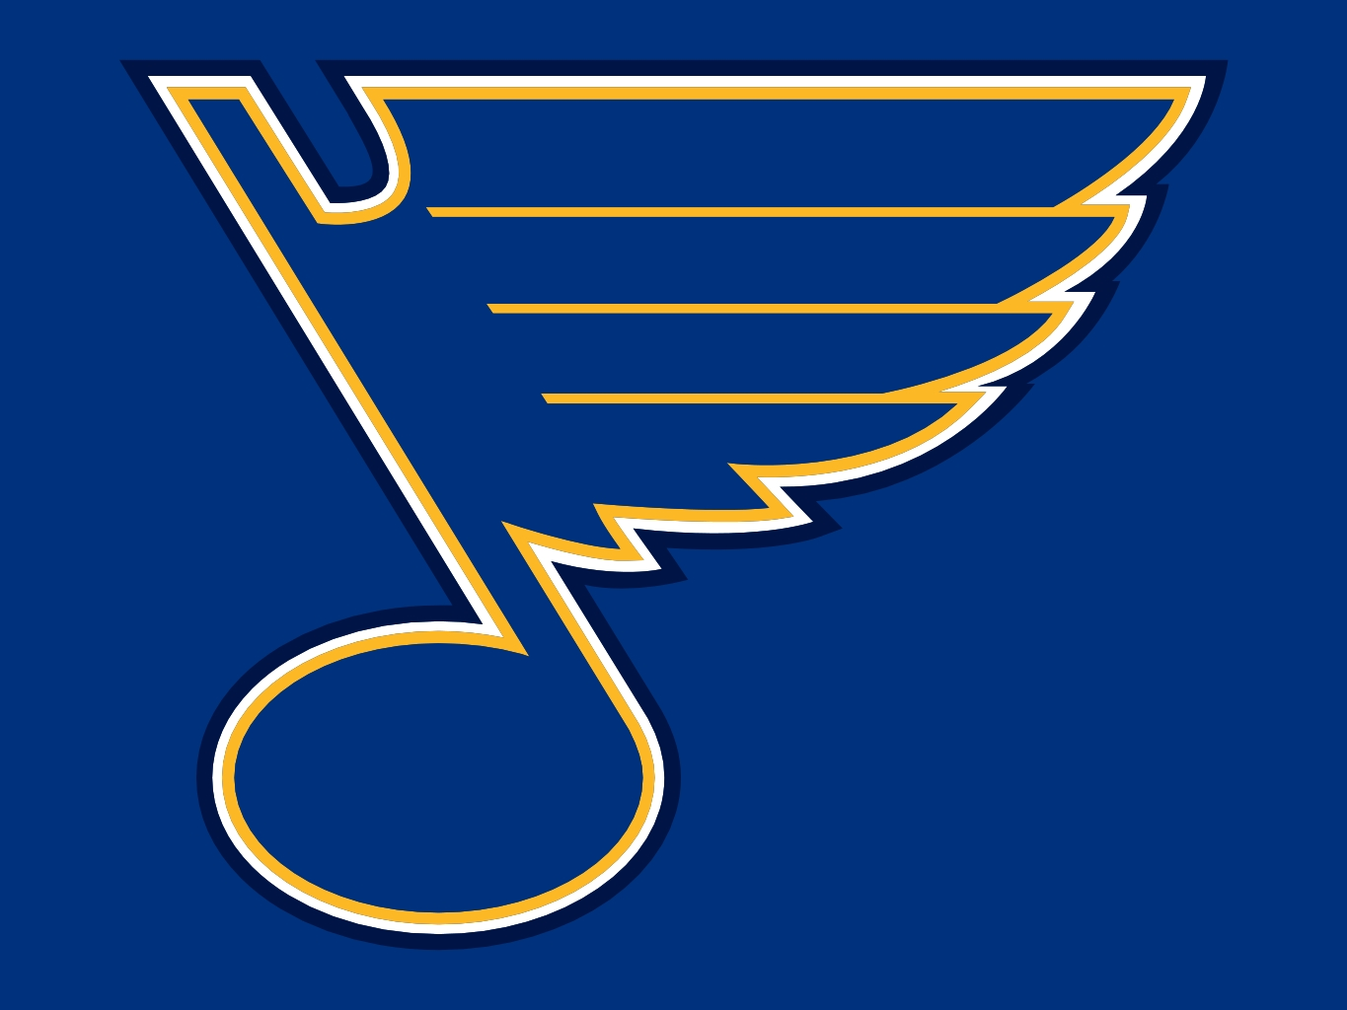
St Louis Blues
Founded in 1967
Play in the Central Division of the Western Conference
The oldest NHL team to have not won the Stanley Cup
The fans have a tradition of selling fan-produced programs outside of the arena

Slide 27
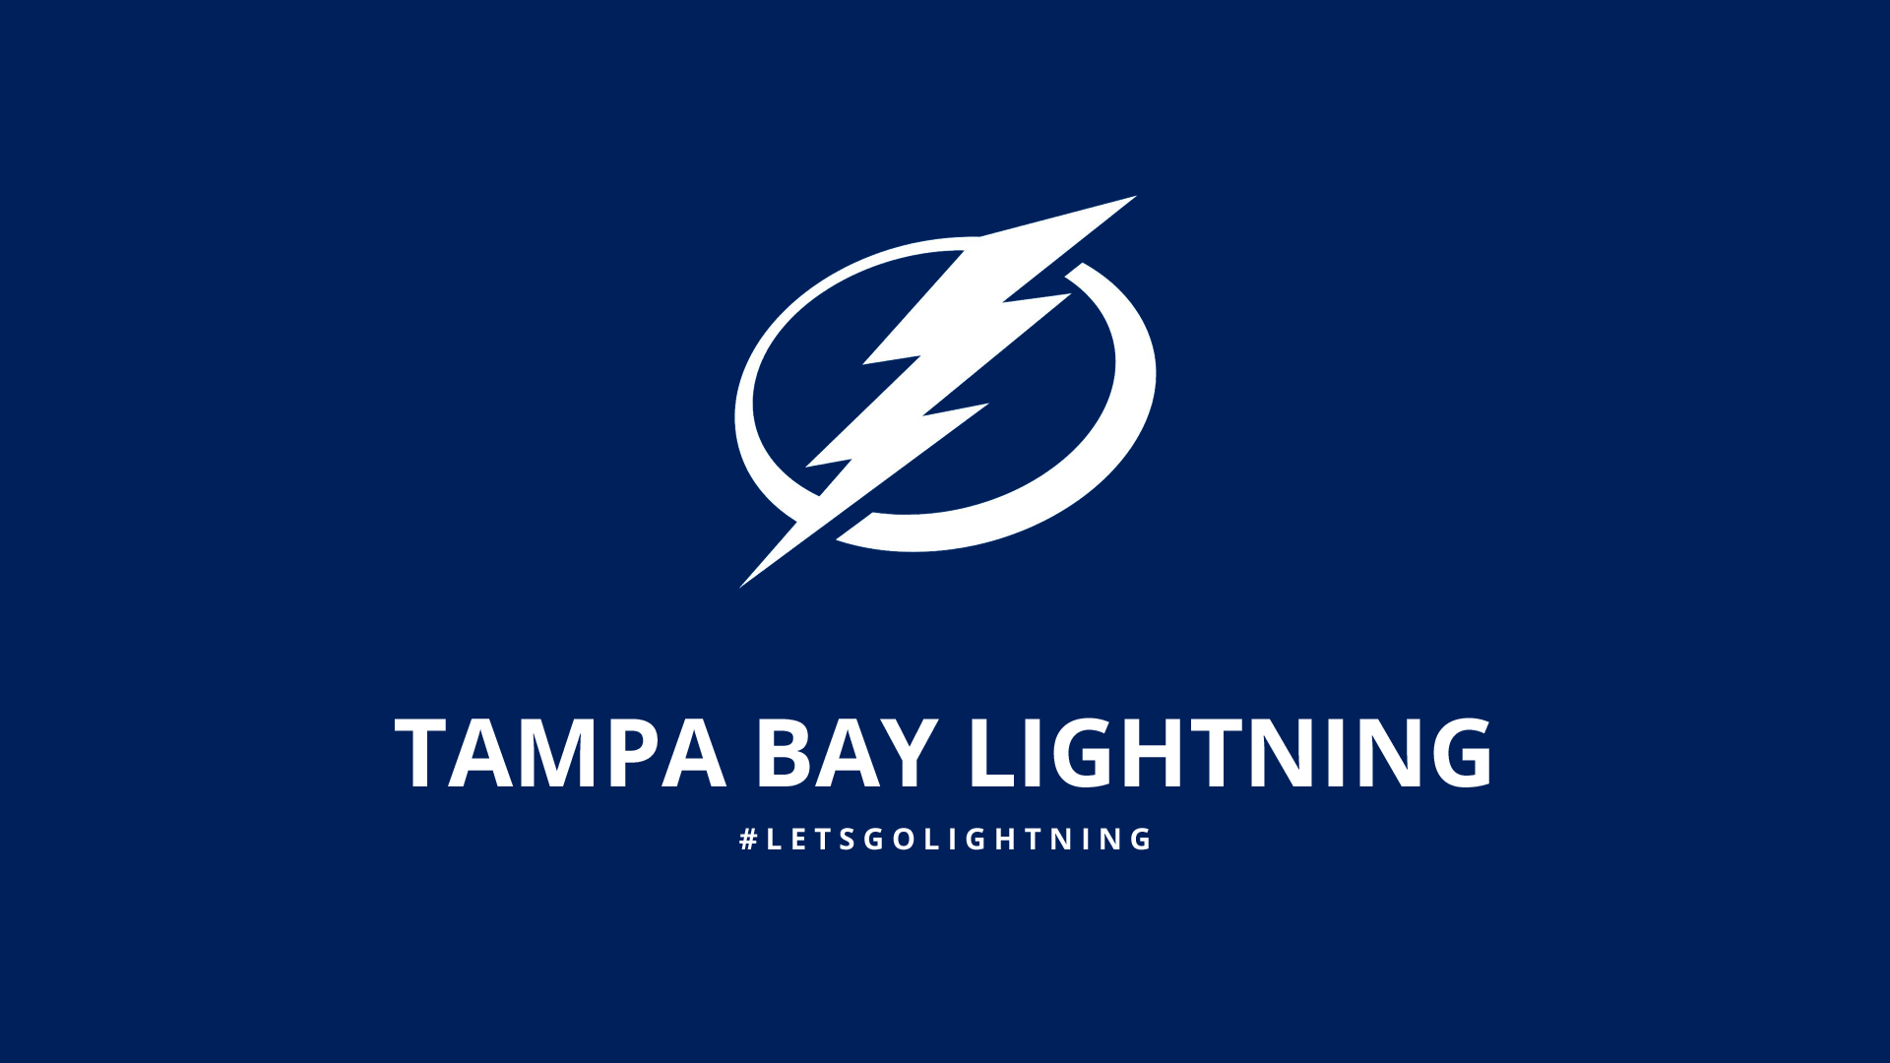
Tampa Bay Lightning
Founded in 1992
Play in the Atlantic Division of the Eastern Conference
Won the Stanley Cup in 2004
Team nickname is the “Bolts”

Slide 28
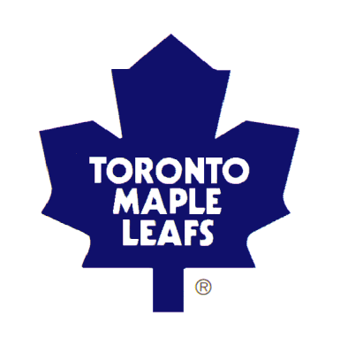
Toronto Maple Leafs
Founded on November 22, 1917
Play in the Atlantic Division of the Eastern Conference
Won 13 Stanley Cups
Worth $1.3 billion (USD), the most valuable NHL franchise
Hold the longest Stanley Cup drought at 48 years but are still tough to get a ticket for a game for a game

Slide 29
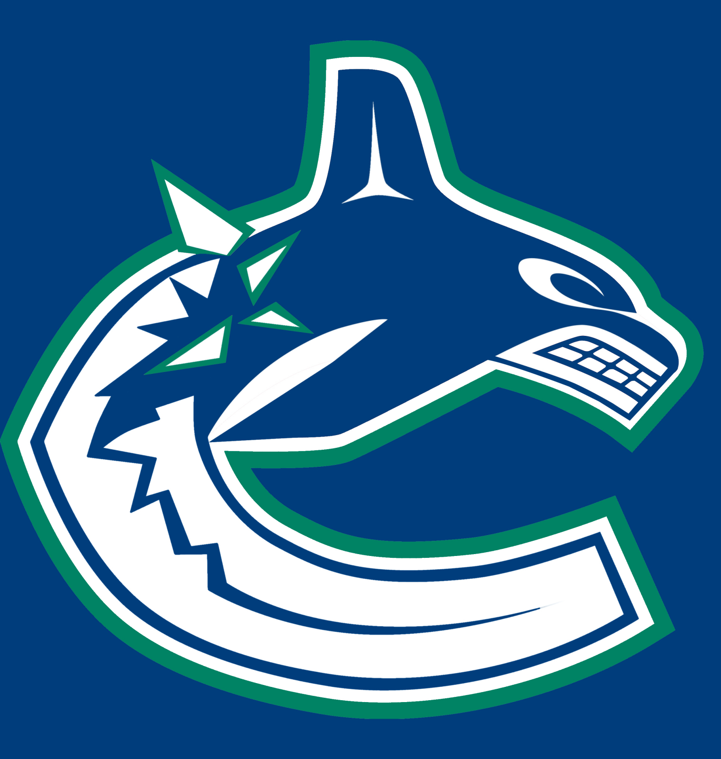
Vancouver Canucks
Founded in 1970
Play in the Pacific Division of the Western Conference
The team has gone through 13 different logo and jersey changes
A killer whale, named Fin, is the team’s mascot and he likes to bite the heads of the fans

Slide 30
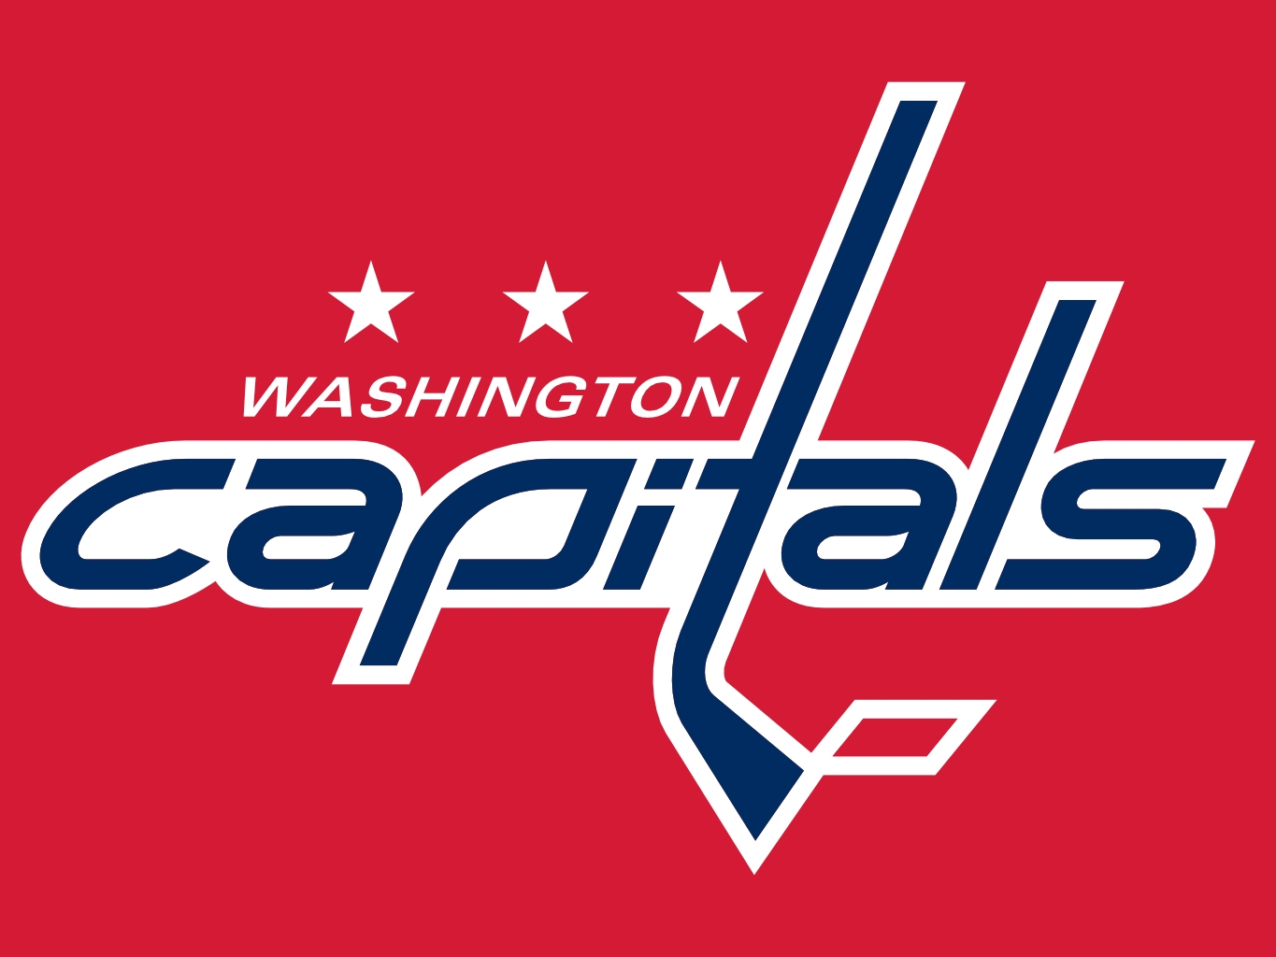
Washington Capitals
Founded in 1974
Play in the Metropolitan Division of the Eastern Conference
The franchise was revitalized in 1999 after new ownership took place

Slide 31
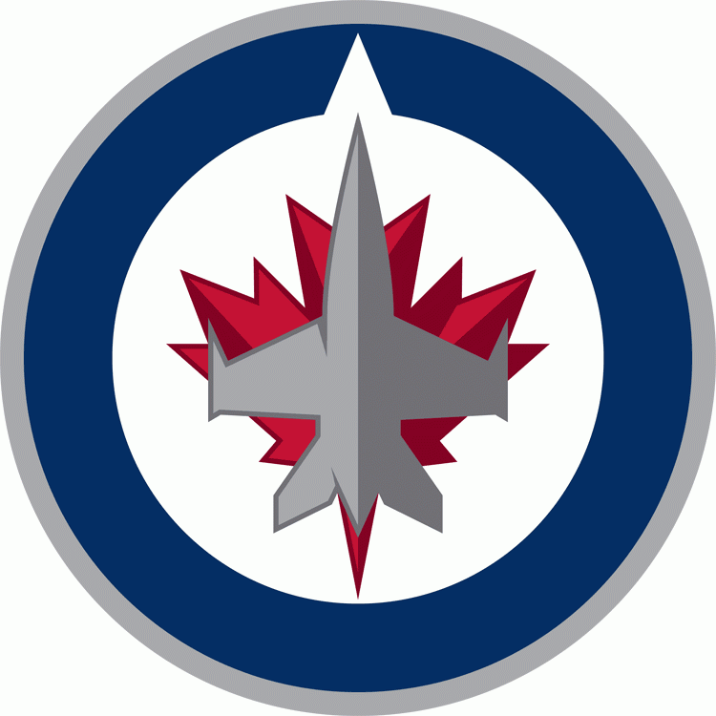
Winnipeg Jets
Founded in 1999 as the Atlanta Thrashers, relocated to Winnipeg in 2011 and were renamed the Jets after the team from 1972-1996
The Winnipeg Whiteout tradition began in 1987 as a trick to create an intimidating atmosphere
The name of the team was kept as a secret from fans until the 2011 draft

Slide 32
Source
https://en.wikipedia.org/wiki/National_Hockey_League#List_of_teams

